Slide 1
Strategies for Managing Team-Based Conflict UAB Department of Pediatrics, New Faculty Orientation Monday August 20, 2018
Anthony C. Hood, PhD
Associate Professor
anthonychood@uab.edu
www.anthonychood.com/managingconflict
205 903-1393
@anthonychood #teamscience #SciTs

Slide 2
What is a team?

Slide 3
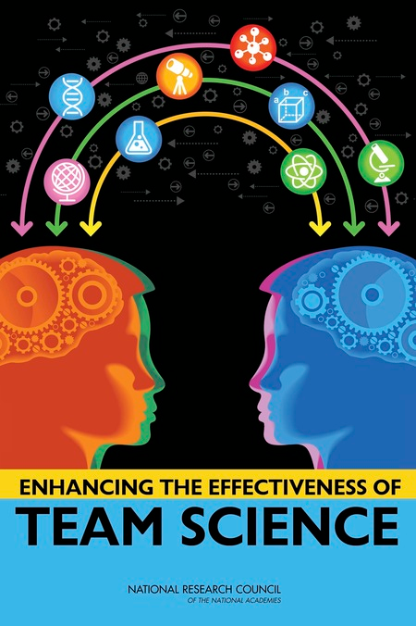
What is a team?
“Two or more individuals with different roles and responsibilities, who interact socially and interdependently within an organizational system to perform tasks and accomplish common goals” (NAP report, p. Sum-1).
Committee on the Science of Team Science, Cooke, N., Hilton, M., Editors. Enhancing the Effectiveness of Team Science. Washington, DC: The National Academies Press; 2015 Apr 24.

Slide 4
What is conflict?

Slide 5
3 Primary Sources of Conflict
Task conflict
Ideas, viewpoints and opinions (Jehn, 1995)
Relationship conflict
Interpersonal incompatibilities, annoyance, frustration (Jehn, 1995)
Process conflict
Task delegation, resource allocation, workload sharing (Jehn & Bendersky, 2003)
Notes:
Tasks, Expertise, People

Slide 6
Conflict can be Contagious
Jehn, K., Rispens, S., Jonsen, K., & Greer, L. (2013). Conflict contagion: a temporal perspective on the development of conflict within teams. International Journal of Conflict Management, 24(4), 352-373.

Slide 7
Conflict can be Multiplex
Hood, A. C., Cruz, K., & Bachrach, D. G. (2016). Conflicts with friends: A multiplex view of friendship and conflict and its association with performance in teams. Journal of Business and Psychology. doi:10.1007/s10869-016-9436-y

Slide 8
Psychological Safety in Teams
“In the context of teams, psychological safety (PS) refers to team members’ assessment that the team’s environment is safe for interpersonal risk-taking (Edmondson, 1999).”
“PS influences willingness to engage in potentially threatening behaviors, such as many of those associated with creativity and learning in groups.”
Hood, A. C., Bachrach, D. G., Zivnuska, S. and Bendoly, E. (2015) Mediating effects of psychological safety in the relationship between team affectivity and transactive memory systems. Journal of Organizational Behavior. http://dx.doi.org/10.1002/job.2050.

Slide 9
Psychological Safety (Edmondson, 1999; Edmondson & Lei, 2013)
Do team members feel comfortable engaging in potentially risky interpersonal behaviors such as:
Admitting errors
Asking for help
Speaking up
Challenging/Questioning/Vetting
Without concern for:
Devaluation, distortion or discounting of expertise
Rejection
Notes:
Tasks, Expertise, People

Slide 10
For Discussion/Next Steps
What are you going to differently as a result of this information?
Can conflict be avoided?
How can you create a psychologically safe team environment?

Slide 11
Questions?

Slide 13
Business Model Canvas: A Tool for Teams

