Slide 1

Teams: The Secret Ingredient for Innovation
UAB MHRC Summer Cancer Research Partnership
Wednesday June 21, 2017
Anthony C. Hood, PhD
Associate Professor
anthonychood@uab.edu
www.anthonychood.com
205 903-1393
@anthonychood #teamscience #SciTs

Slide 2
Objectives: At the conclusion of this workshop, participants will be able to identify and describe:
Importance of teams to scientific innovation
Primary types of conflict in teams
Personality differences
Psychological safety

Slide 3
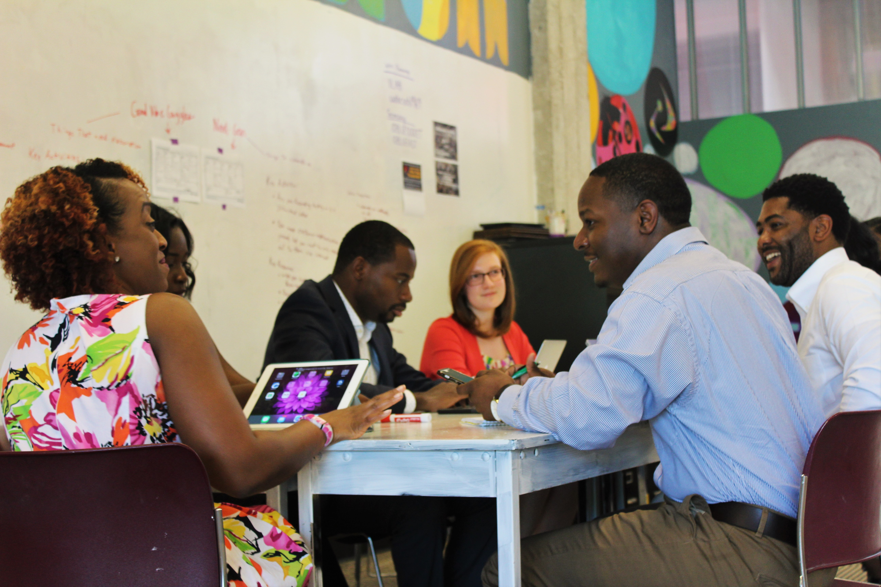
What is a team?

Slide 4

What is a team?
“Two or more individuals with different roles and responsibilities, who interact socially and interdependently within an organizational system to perform tasks and accomplish common goals” (NAP report, p. Sum-1).
Committee on the Science of Team Science, Cooke, N., Hilton, M., Editors. Enhancing the Effectiveness of Team Science. Washington, DC: The National Academies Press; 2015 Apr 24.

Slide 5
Current trends in scientific research
90% of all science and engineering pubs are by 2 or more authors
Most pubs authored by 6-10 researchers across multiple institutions
Researchers are not always academics
Team size continues to increase
Committee on the Science of Team Science, Cooke, N., Hilton, M., Editors. Enhancing the Effectiveness of Team Science. Washington, DC: The National Academies Press; 2015 Apr 24.

Slide 6
What is Team Science?
“Team science is a collaborative effort to address a scientific challenge that leverages the strengths and expertise of professionals trained in different fields.” (www.teamsciencetoolkit.cancer.gov/Public/WhatIsTS.aspx)
“Team science initiatives are designed to promote collaborative – and often cross-disciplinary – approaches to analyzing research questions about particular phenomena…” (Stokols, Hall, Taylor, & Moser, 2008, pp. S77-78)
“Teams have emerged as a pivotal form for organizing translational science efforts. Such teams involve multiple stakeholders who are increasingly drawn from a variety of disciplinary and organizational boundaries and serve a variety of roles.” (Winter & Berente, 2012, p. 443)
“More specifically, ‘team science’ is expected to combine specialized expertise, theoretical approaches, and research methods across disciplinary boundaries, solving… complex problems and producing high-impact science.” (Börner et al., 2010, p. 1)

Slide 7
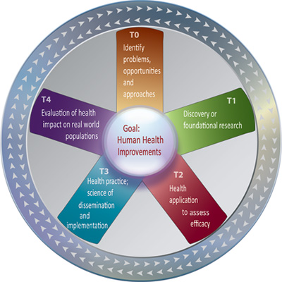
Translational Science Paradigm
U. Of Washington, T-Phases https://www.iths.org/investigators/definitions/translational-research

Slide 8

Patient Centered Outcomes Research Institute (PCORI )
http://www.theamericannurse.org/index.php/2012/04/02/supporting-research-with-patient-centered-outcomes/

Slide 9
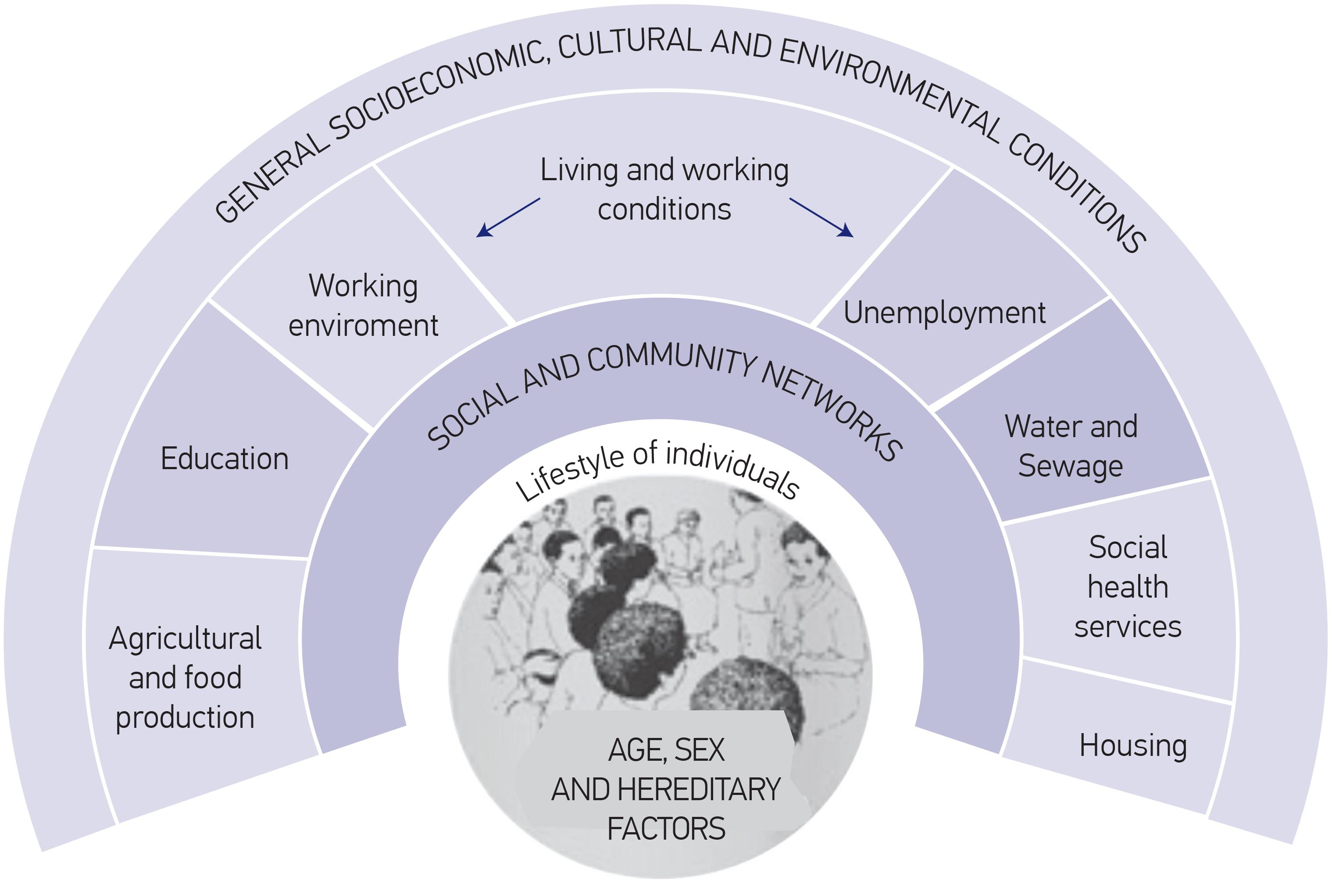
Social Determinants of Health

Slide 10
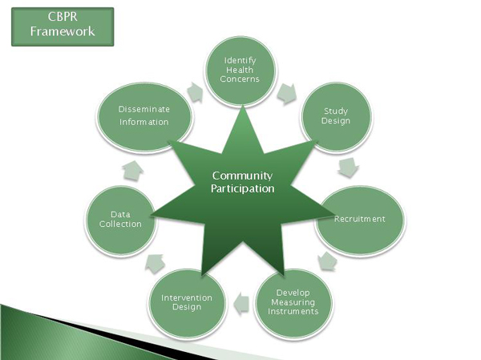

Community-Based Participatory Research
Source: https://ui.uncc.edu/story/geographers-doctors-and-community-members
Source: http://cssr.gmu.edu/cssr-capabilities/community-based-participatory-research

Slide 11
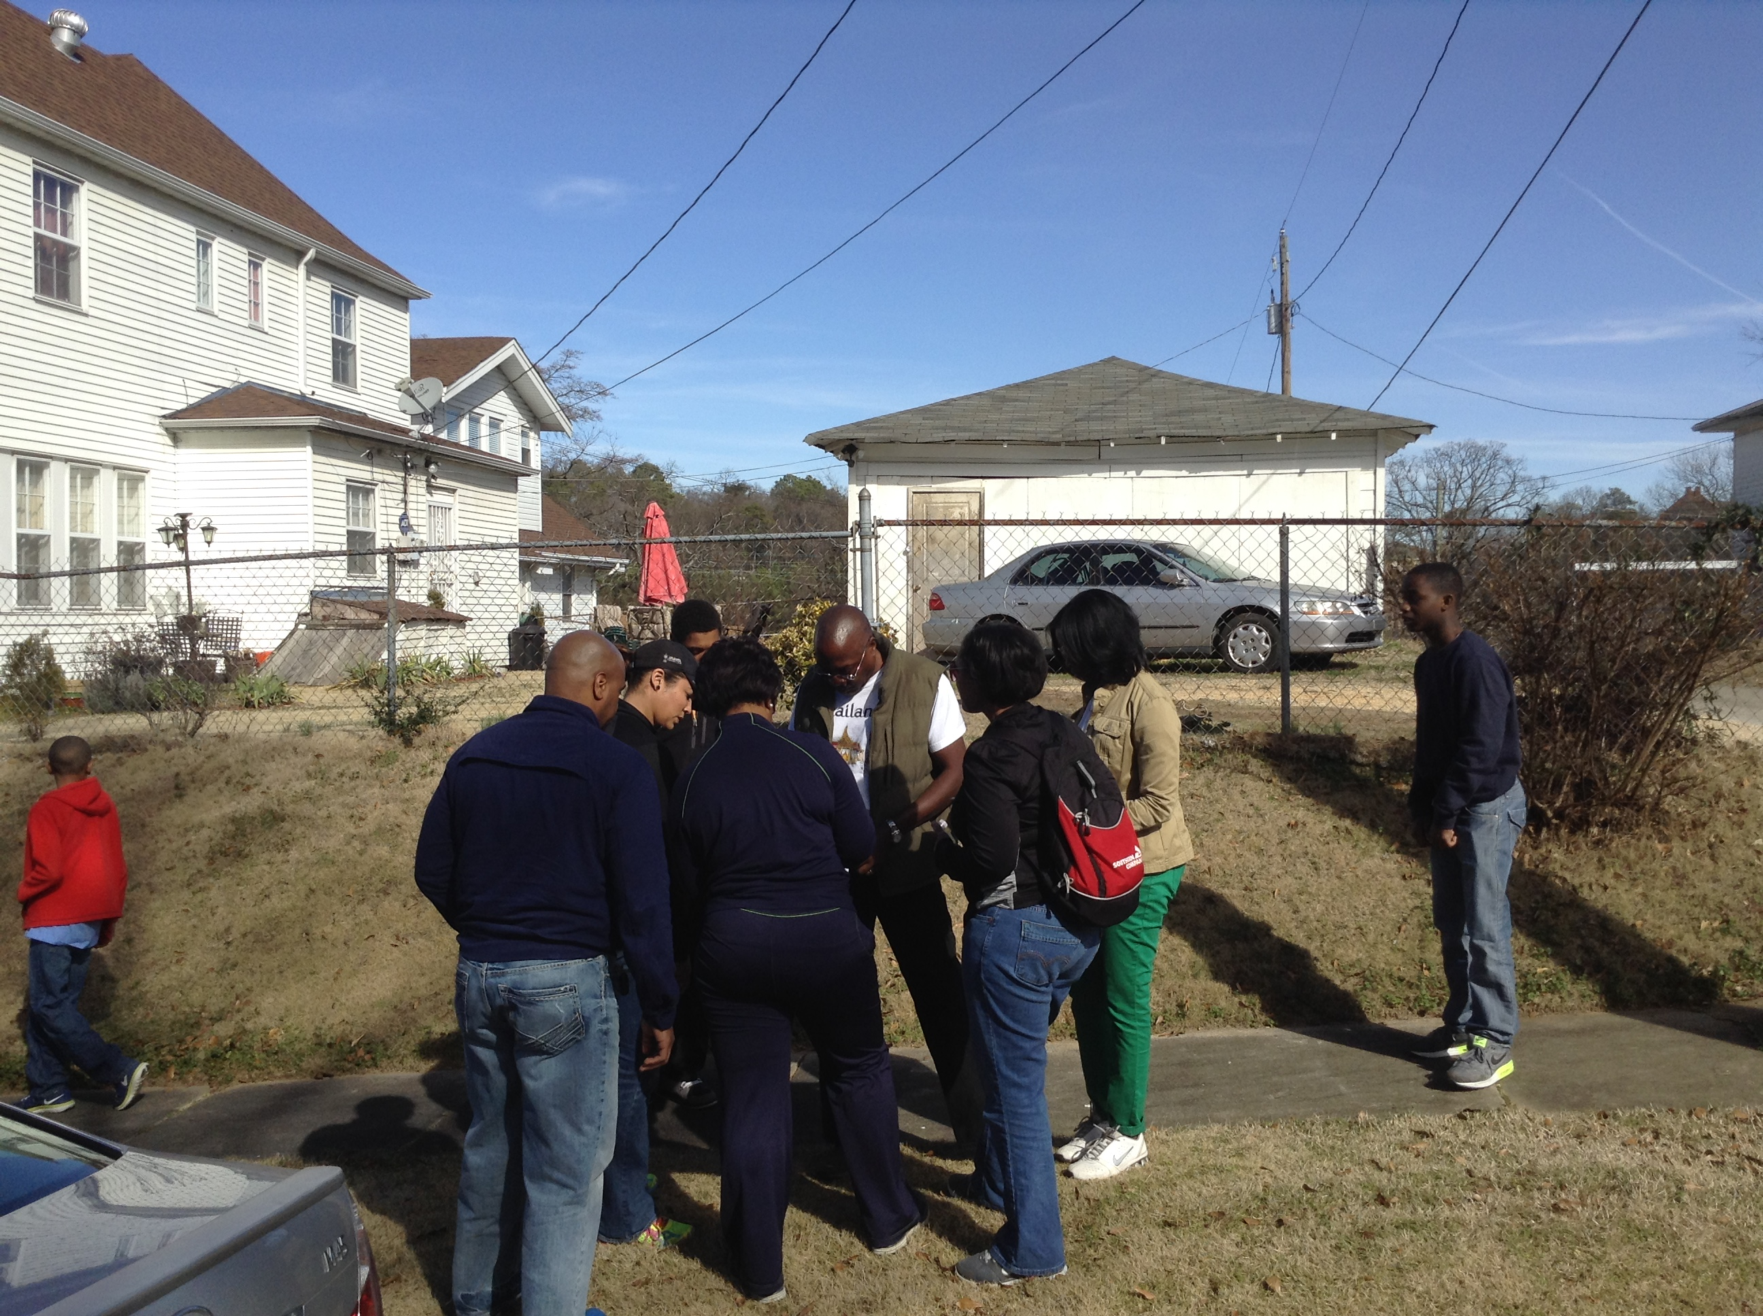
Community Health Research: Tracking Vacant and Abandoned Property

Slide 12
Translational Science Continuum
U. Of Washington, T-Phases https://www.iths.org/investigators/definitions/translational-research

Slide 13
The Business of Teamwork
Team-Based Creativity
  The exchange and combination of divergent yet complementary bits of information between 2 or more team members that produces something that is both novel and potentially useful (Amabile, 1983; Amabile et al., 1996; Gino et al., 2010; Nahapiet & Ghoshal, 1998)
Team-Based Innovation
  Implementation of a novel or useful discovery or product (Hulsheger et al., 2009)
  Translation (taking action to move and transform the idea from one phase to another)

Slide 14
The Business of Teamwork
Team-Based Entrepreneurship
    Opportunity-seeking behavior.
    Commercialization. Tech transfer. Start-up activity. University spin-offs. Intellectual property. Licensing. Patent protection. Business incubation.
    Income generation. Profit maximization. Wealth creation.
Team-Based Strategy
Advantage-seeking behavior.
How to out-perform and out-compete others. (e.g. Ireland, Hitt and Simon, 2003)
Sustainability. Long-range planning.
Notes:
“Situations in which new goods, services, raw materials, markets and organizing methods can be introduced through the formation of new means, ends, or means-ends relationships.” (Casson, 1982; Shane and Venkat, 2000)

Slide 15
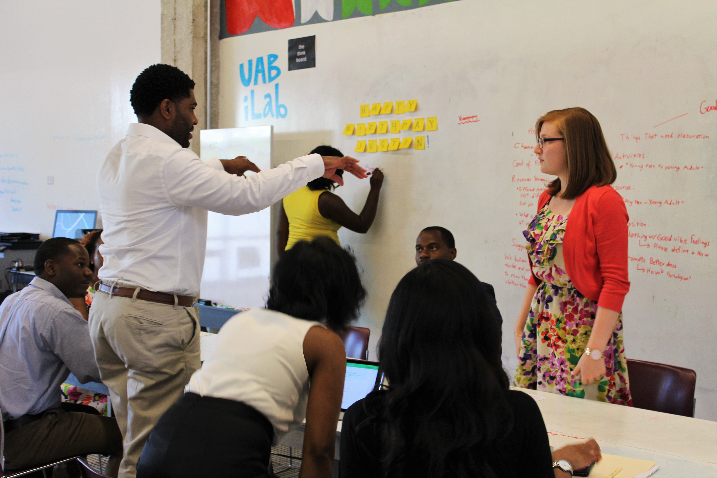
What is conflict?

Slide 16
3 Primary Sources of Conflict
Task conflict
  Ideas, viewpoints and opinions (Jehn, 1995)
Relationship conflict
  Interpersonal incompatibilities, annoyance, frustration (Jehn, 1995)
Process conflict
  Task delegation, resource allocation, workload sharing (Jehn & Bendersky, 2003)
Notes:
Tasks, Expertise, People

Slide 17
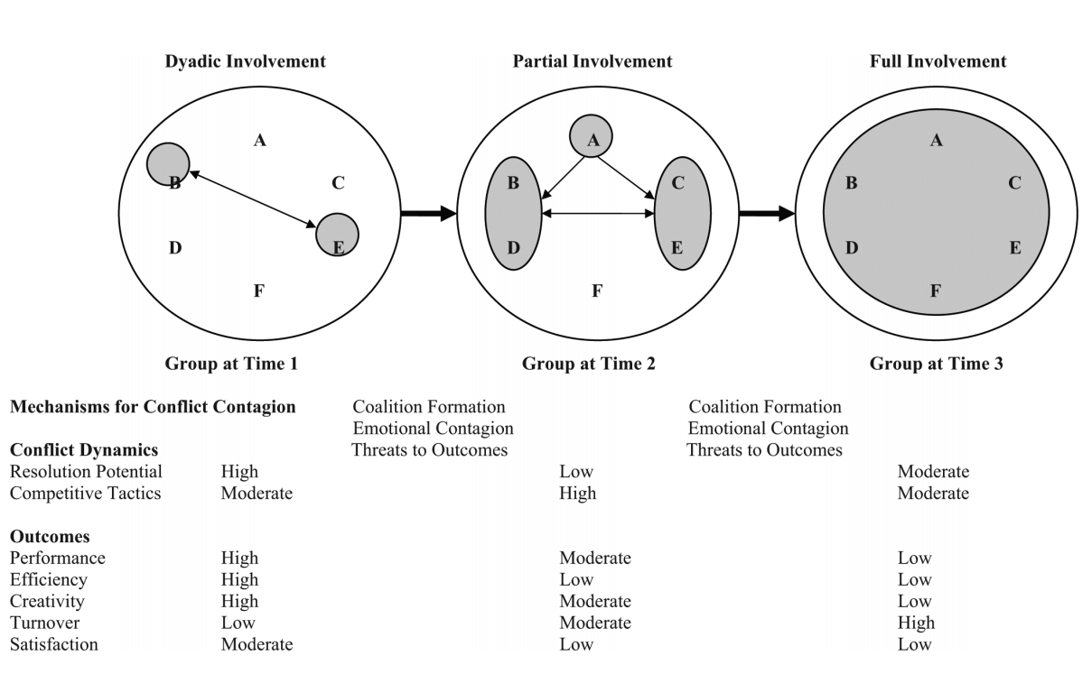
Conflict can be Contagious
Jehn, K., Rispens, S., Jonsen, K., & Greer, L. (2013). Conflict contagion: a temporal perspective on the development of conflict within teams. International Journal of Conflict Management, 24(4), 352-373.

Slide 18
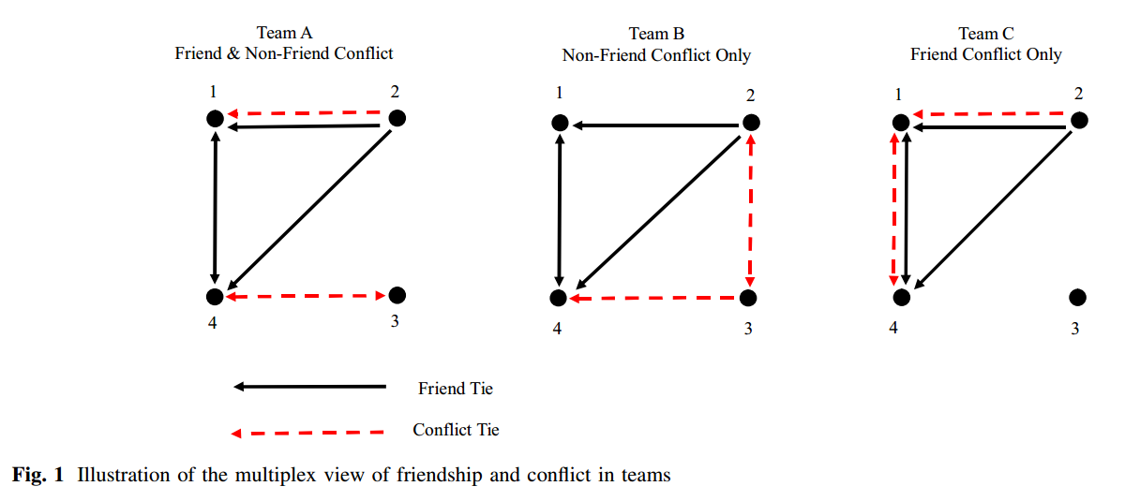
Conflict can be Multiplex
Hood, A. C., Cruz, K., & Bachrach, D. G. (2016). Conflicts with friends: A multiplex view of friendship and conflict and its association with performance in teams. Journal of Business and Psychology. doi:10.1007/s10869-016-9436-y

Slide 19
Psychological Safety in Teams
“In the context of teams, psychological safety (PS) refers to team members’ assessment that the team’s environment is safe for interpersonal risk-taking (Edmondson, 1999).”
“PS influences willingness to engage in potentially threatening behaviors, such as many of those associated with creativity and learning in groups.”
Hood, A. C., Bachrach, D. G., Zivnuska, S. and Bendoly, E. (2015) Mediating effects of psychological safety in the relationship between team affectivity and transactive memory systems. Journal of Organizational Behavior. http://dx.doi.org/10.1002/job.2050.

Slide 20
Psychological Safety (Edmondson, 1999; Edmondson & Lei, 2013)
Do team members feel comfortable engaging in potentially risky interpersonal behaviors such as:
Admitting errors
Asking for help
Speaking up
Challenging/Questioning/Vetting
Without concern for:
Devaluation, distortion or discounting of expertise
Rejection
Notes:
Tasks, Expertise, People

Slide 21
For Discussion/Next Steps
What are you going to differently as a result of this information?
Can conflict be avoided?
How can you create a psychologically safe team environment?

Slide 22
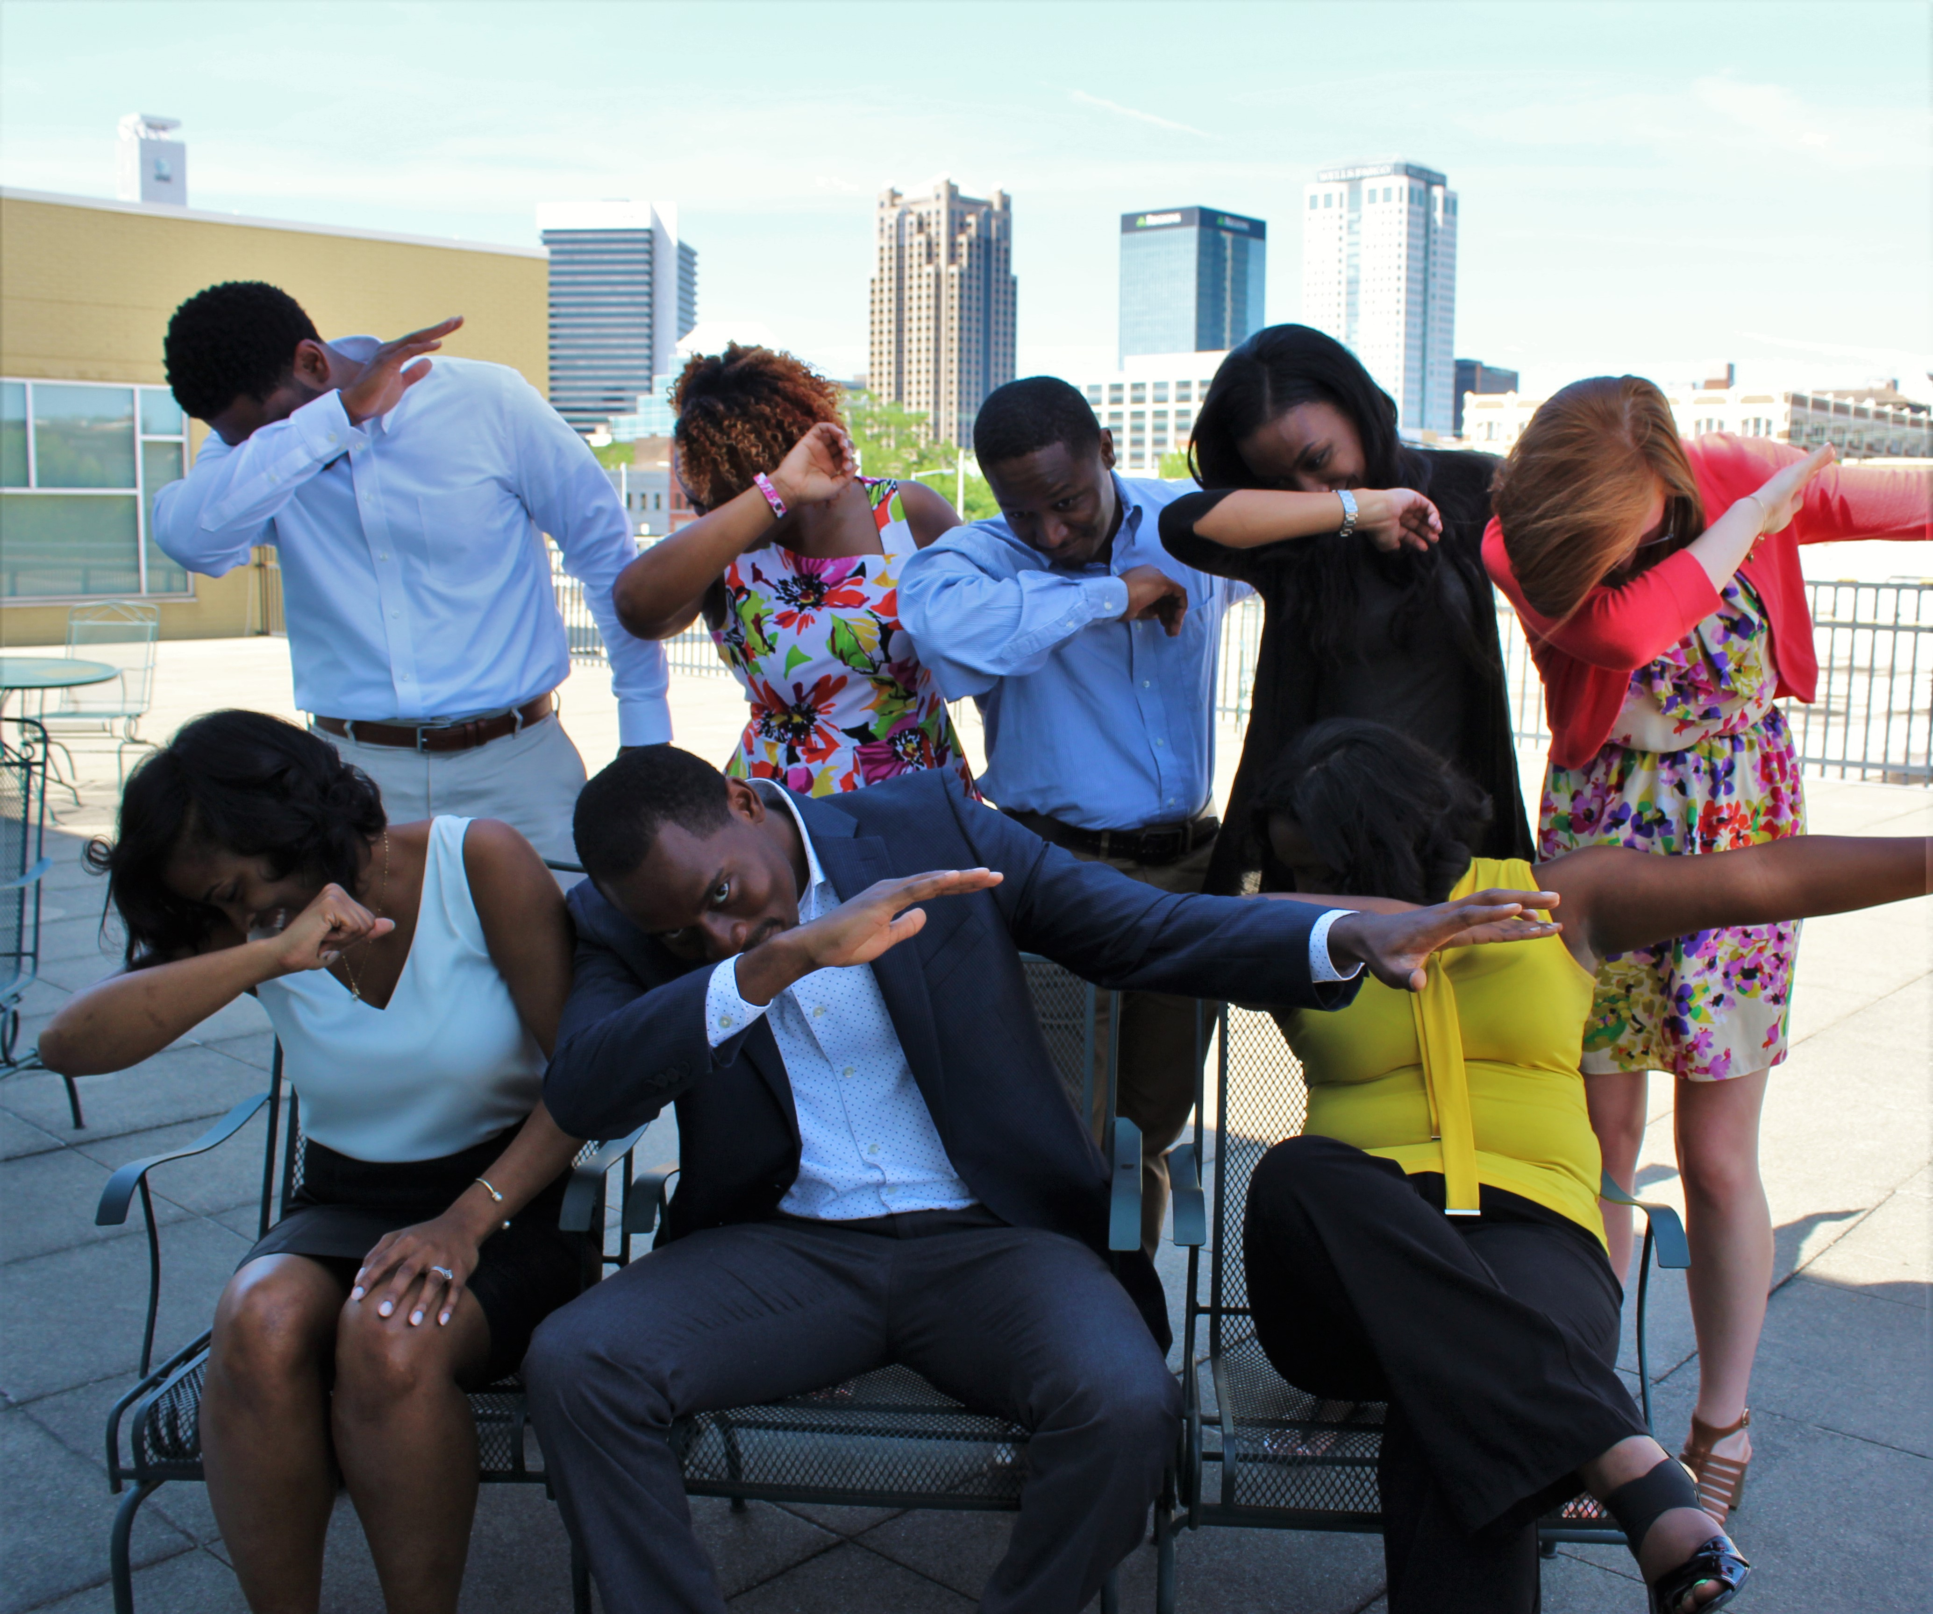
Questions?

