Slide 1
Teams: The Secret Ingredient for Innovation Team Science and Communication Workshop UAB KURE Monday June 19, 2017
Anthony C. Hood, PhD
Assistant Professor
anthonychood@uab.edu
www.anthonychood.com
205 903-1393
@anthonychood #teamscience #SciTs

Slide 2
Objectives: At the conclusion of this workshop, participants will be able to identify and describe:
Importance of teams to scientific innovation
Primary types of conflict in teams
Personality differences
Psychological safety

Slide 3
What is a team?

Slide 4
What is a team?
“Two or more individuals with different roles and responsibilities, who interact socially and interdependently within an organizational system to perform tasks and accomplish common goals” (NAP report, p. Sum-1).
Committee on the Science of Team Science, Cooke, N., Hilton, M., Editors. Enhancing the Effectiveness of Team Science. Washington, DC: The National Academies Press; 2015 Apr 24.

Slide 5
Current trends in scientific research
90% of all science and engineering pubs are by 2 or more authors
Most pubs authored by 6-10 researchers across multiple institutions
Researchers are not always academics
Team size continues to increase
Committee on the Science of Team Science, Cooke, N., Hilton, M., Editors. Enhancing the Effectiveness of Team Science. Washington, DC: The National Academies Press; 2015 Apr 24.

Slide 6
What is Team Science?
“Team science is a collaborative effort to address a scientific challenge that leverages the strengths and expertise of professionals trained in different fields.” (www.teamsciencetoolkit.cancer.gov/Public/WhatIsTS.aspx)
“Team science initiatives are designed to promote collaborative – and often cross-disciplinary – approaches to analyzing research questions about particular phenomena…” (Stokols, Hall, Taylor, & Moser, 2008, pp. S77-78)
“Teams have emerged as a pivotal form for organizing translational science efforts. Such teams involve multiple stakeholders who are increasingly drawn from a variety of disciplinary and organizational boundaries and serve a variety of roles.” (Winter & Berente, 2012, p. 443)
“More specifically, ‘team science’ is expected to combine specialized expertise, theoretical approaches, and research methods across disciplinary boundaries, solving… complex problems and producing high-impact science.” (Börner et al., 2010, p. 1)

Slide 7
Translational Science Paradigm
U. Of Washington, T-Phases https://www.iths.org/investigators/definitions/translational-research

Slide 8
Patient Centered Outcomes Research Institute (PCORI )
http://www.theamericannurse.org/index.php/2012/04/02/supporting-research-with-patient-centered-outcomes/

Slide 9
Social Determinants of Health

Slide 10
Community-Based Participatory Research
Source: https://ui.uncc.edu/story/geographers-doctors-and-community-members
Source: http://cssr.gmu.edu/cssr-capabilities/community-based-participatory-research

Slide 11
Community Health Research: Tracking Vacant and Abandoned Property

Slide 12
UAB Office of Interprofessional Simulation for Innovative Clinical Practice

Slide 13
Translational Science Continuum
U. Of Washington, T-Phases https://www.iths.org/investigators/definitions/translational-research

Slide 14
The Business of Quality Improvement
Team-Based Creativity
The exchange and combination of divergent yet complementary bits of information between 2 or more team members that produces something that is both novel and potentially useful (Amabile, 1983; Amabile et al., 1996; Gino et al., 2010; Nahapiet & Ghoshal, 1998)
Team-Based Innovation
Implementation of a novel or useful discovery or product (Hulsheger et al., 2009)
Translation (taking action to move and transform the idea from one phase to another)

Slide 15
The Business of Quality Improvement
Team-Based Entrepreneurship
Opportunity-seeking behavior.
Commercialization. Tech transfer. Start-up activity. University spin-offs. Intellectual property. Licensing. Patent protection. Business incubation.
Income generation. Profit maximization. Wealth creation.
Team-Based Strategy
Advantage-seeking behavior.
How to out-perform and out-compete others. (e.g. Ireland, Hitt and Simon, 2003)
Sustainability. Long-range planning.
Notes:
“Situations in which new goods, services, raw materials, markets and organizing methods can be introduced through the formation of new means, ends, or means-ends relationships.” (Casson, 1982; Shane and Venkat, 2000)

Slide 16
What is conflict?

Slide 17
3 Primary Sources of Conflict
Task conflict
Ideas, viewpoints and opinions (Jehn, 1995)
Relationship conflict
Interpersonal incompatibilities, annoyance, frustration (Jehn, 1995)
Process conflict
Task delegation, resource allocation, workload sharing (Jehn & Bendersky, 2003)
Notes:
Tasks, Expertise, People

Slide 18
5 Manifestations of Conflict
Conflict can be:
Skewed (Sinha et al., 2016)
Asymmetric (Jehn et al., 2010)
Transformed (Greer et al., 2008)
Multiplex (Hood et al., 2016)
Contagious (Jehn et al., 2013)
Notes:
Tasks, Expertise, People

Slide 19
Conflict can be Contagious
Jehn, K., Rispens, S., Jonsen, K., & Greer, L. (2013). Conflict contagion: a temporal perspective on the development of conflict within teams. International Journal of Conflict Management, 24(4), 352-373.

Slide 20
Conflict can be Skewed
Sinha, R., Janardhanan, N. S., Greer, L. L., Conlon, D. E., & Edwards, J. R. (2016). Skewed Task Conflicts in Teams: What Happens When a Few Members See More Conflict Than the Rest? Journal of Applied Psychology. doi: http://dx.doi.org/10.1037/apl0000059

Slide 21
Conflict can be Multiplex
Hood, A. C., Cruz, K., & Bachrach, D. G. (2016). Conflicts with friends: A multiplex view of friendship and conflict and its association with performance in teams. Journal of Business and Psychology. doi:10.1007/s10869-016-9436-y

Slide 22
Conflict can be Miscalculated
Cogliser, C. C., Schriesheim, C. A., Scandura, T. A., & Gardner, W. L. (2009). Balance in leader and follower perceptions of leader–member exchange: Relationships with performance and work attitudes. The Leadership Quarterly, 20(3), 452-465.

Slide 23
Psychological Safety in Teams
“In the context of teams, psychological safety (PS) refers to team members’ assessment that the team’s environment is safe for interpersonal risk-taking (Edmondson, 1999).”
“PS influences willingness to engage in potentially threatening behaviors, such as many of those associated with creativity and learning in groups.”
Hood, A. C., Bachrach, D. G., Zivnuska, S. and Bendoly, E. (2015) Mediating effects of psychological safety in the relationship between team affectivity and transactive memory systems. Journal of Organizational Behavior. http://dx.doi.org/10.1002/job.2050.

Slide 24
Psychological Safety (Edmondson, 1999; Edmondson & Lei, 2013)
Do team members feel comfortable engaging in potentially risky interpersonal behaviors such as:
Admitting errors
Asking for help
Speaking up
Challenging/Questioning/Vetting
Without concern for:
Devaluation, distortion or discounting of expertise
Rejection
Notes:
Tasks, Expertise, People

Slide 25
Questions?

Slide 26
Transactive Memory Systems (TMS)- Mental Model of Tasks, Expertise and People
Tasks | Expertise | People
Brandon, D. P., & Hollingshead, A. B. (2004). Transactive Memory Systems in Organizations: Matching Tasks, Expertise, and People. Organization Science, 15(6), 633-644. doi:10.1287/orsc.1040.0069
Notes:
Each team member has some form of cognitive directory that varies in its accuracy and completeness. This directory represents that person’s individual transactive memory. The degree to which there is congruence between each members’ TM determines the extent to which a team/network possesses a well-developed TM System. (see Brandon & Hollingshead, 2004)

Slide 27
Transactive Memory Systems (TMS)- Mental Model of Tasks, Expertise and People
Tasks | Expertise | People
Grantsmanship | ?? | Susan
Data analysis | Biostats | ??
Comm Organizing | Church Leader | ??
?? | Health Disparities | Karen
Publish | ?? | John
Health Screenings | Clinician | Chris
Qualitative Surveys | CBPR | ??
Brandon, D. P., & Hollingshead, A. B. (2004). Transactive Memory Systems in Organizations: Matching Tasks, Expertise, and People. Organization Science, 15(6), 633-644. doi:10.1287/orsc.1040.0069
Notes:
Each team member has some form of cognitive directory that varies in its accuracy and completeness. This directory represents that person’s individual transactive memory. The degree to which there is congruence between each members’ TM determines the extent to which a team/network possesses a well-developed TM System. (see Brandon & Hollingshead, 2004)

Slide 28
Business Model Canvas: A Tool for Teams

Slide 29
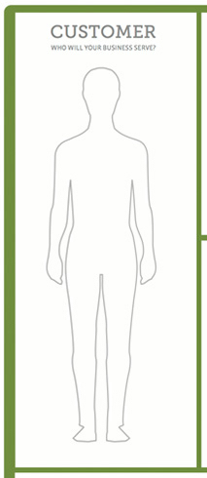
Customer
Recipients of care/treatment
Research Subjects
Sample/Patient Populations
Funders
Peer Reviewers
End users (e.g. physicians, care givers, etc)

Slide 30
Problem
Conditions/Diagnosis
Food Desert, Blight, Crime
Prevalence/Severity/Frequency
Physician/Caregiver challenges
Pains, Gains, Jobs to be Done
Gaps in theory/practice

Slide 31
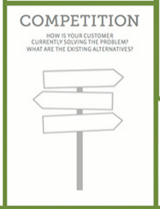
Competition
Current plans of care/treatment
Alternatives
Effectiveness
Satisfaction with current care/treatment
Competing theories, research teams, etc

Slide 32
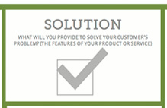
Solution
Proposed plan of care/treatment/intervention
Value Proposition
Specific Aims

Slide 33
Benefit
Proposed benefit to subjects?
How does the proposed science:
Relieve pains?
Create desired gains?
Facilitate getting jobs done more cheaply or efficiently?
Theoretical Contributions
Practical Contributions

Slide 34
Advantage
Novelty/Innovation
Why should subjects enroll or remain in the study?
Why should your science be funded? Published?
Why should providers adopt your product or approach over competing alternatives?

Slide 35
Message
What is your “brand”?
How will you establish and build trust?
How will your subjects, funders, peers and end users learn about your work?
What are your plans for recruitment, enrollment and retention?

Slide 36
Distribution
Research Design?
Where will the research be conducted?
Lab, field study, CBPR, point of care, etc
What is your dissemination plan?
Journal outlets?
What is your plan for translation, implementation, commercialization, etc?

Slide 37
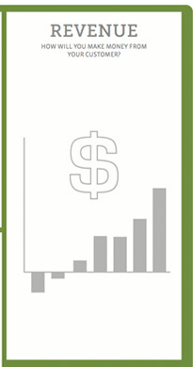
Revenue
Funding sources
Federal grants
Foundations
Fee-for-service
Industry-sponsored
Intramural funding

Slide 38
Startup Needs
Non-recurring costs
Lab space, equipment, recruitment incentives, technology
Costs for pilot studies

Slide 39
Costs
Ongoing costs once the study begins
Space rental, salary support, supplies
Direct/indirect costs
Time
Emotional Energy

Slide 40
Performance Evaluation
Holding strategic planning retreats/kickoffs
Project management
Quarterly/Annual review
Documenting activity
Monitoring progress towards stated objectives
Making corrective adjustments as needed
Vision casting for next Q/Y

Slide 41
Business Model Canvas: A Tool for Teams

Slide 42
12 Potential Sources of Business Model Innovation Conflicts (Blank, 2013; Osterwalder & Pigneur, 2010)
1. Customer
2. Problem
3. Competition
4. Solution
5. Benefit
Advantage
7. Message
8. Distribution
9. Revenue
10. Startup Needs
11. Costs
12. Evaluation
Notes:
Tasks, Expertise, People

Slide 43
Translational Science Paradigm
U. Of Washington, T-Phases https://www.iths.org/investigators/definitions/translational-research

Slide 44
Patient Centered Outcomes Research Institute (PCORI )
http://www.theamericannurse.org/index.php/2012/04/02/supporting-research-with-patient-centered-outcomes/

Slide 45
Community-Based Participatory Research
Source: https://ui.uncc.edu/story/geographers-doctors-and-community-members
Source: http://cssr.gmu.edu/cssr-capabilities/community-based-participatory-research

Slide 46
Community Health Research: Tracking Vacant and Abandoned Property

Slide 47
Social Determinants of Health

Slide 48
Agency for Healthcare Research and Quality (AHRQ) TeamSTEPPS®: Strategies and Tools to Enhance Performance and Patient Safety

Slide 49
UAB Office of Interprofessional Simulation for Innovative Clinical Practice

Slide 50
UAB Office of Interprofessional Simulation for Innovative Clinical Practice

Slide 51
Grant Funding is a Team Sport
www.birminghamchangefund.org

Slide 52
NSF Innovation Corps and I-Corps™ at NIH

Slide 53
Business School Faculty

Slide 54
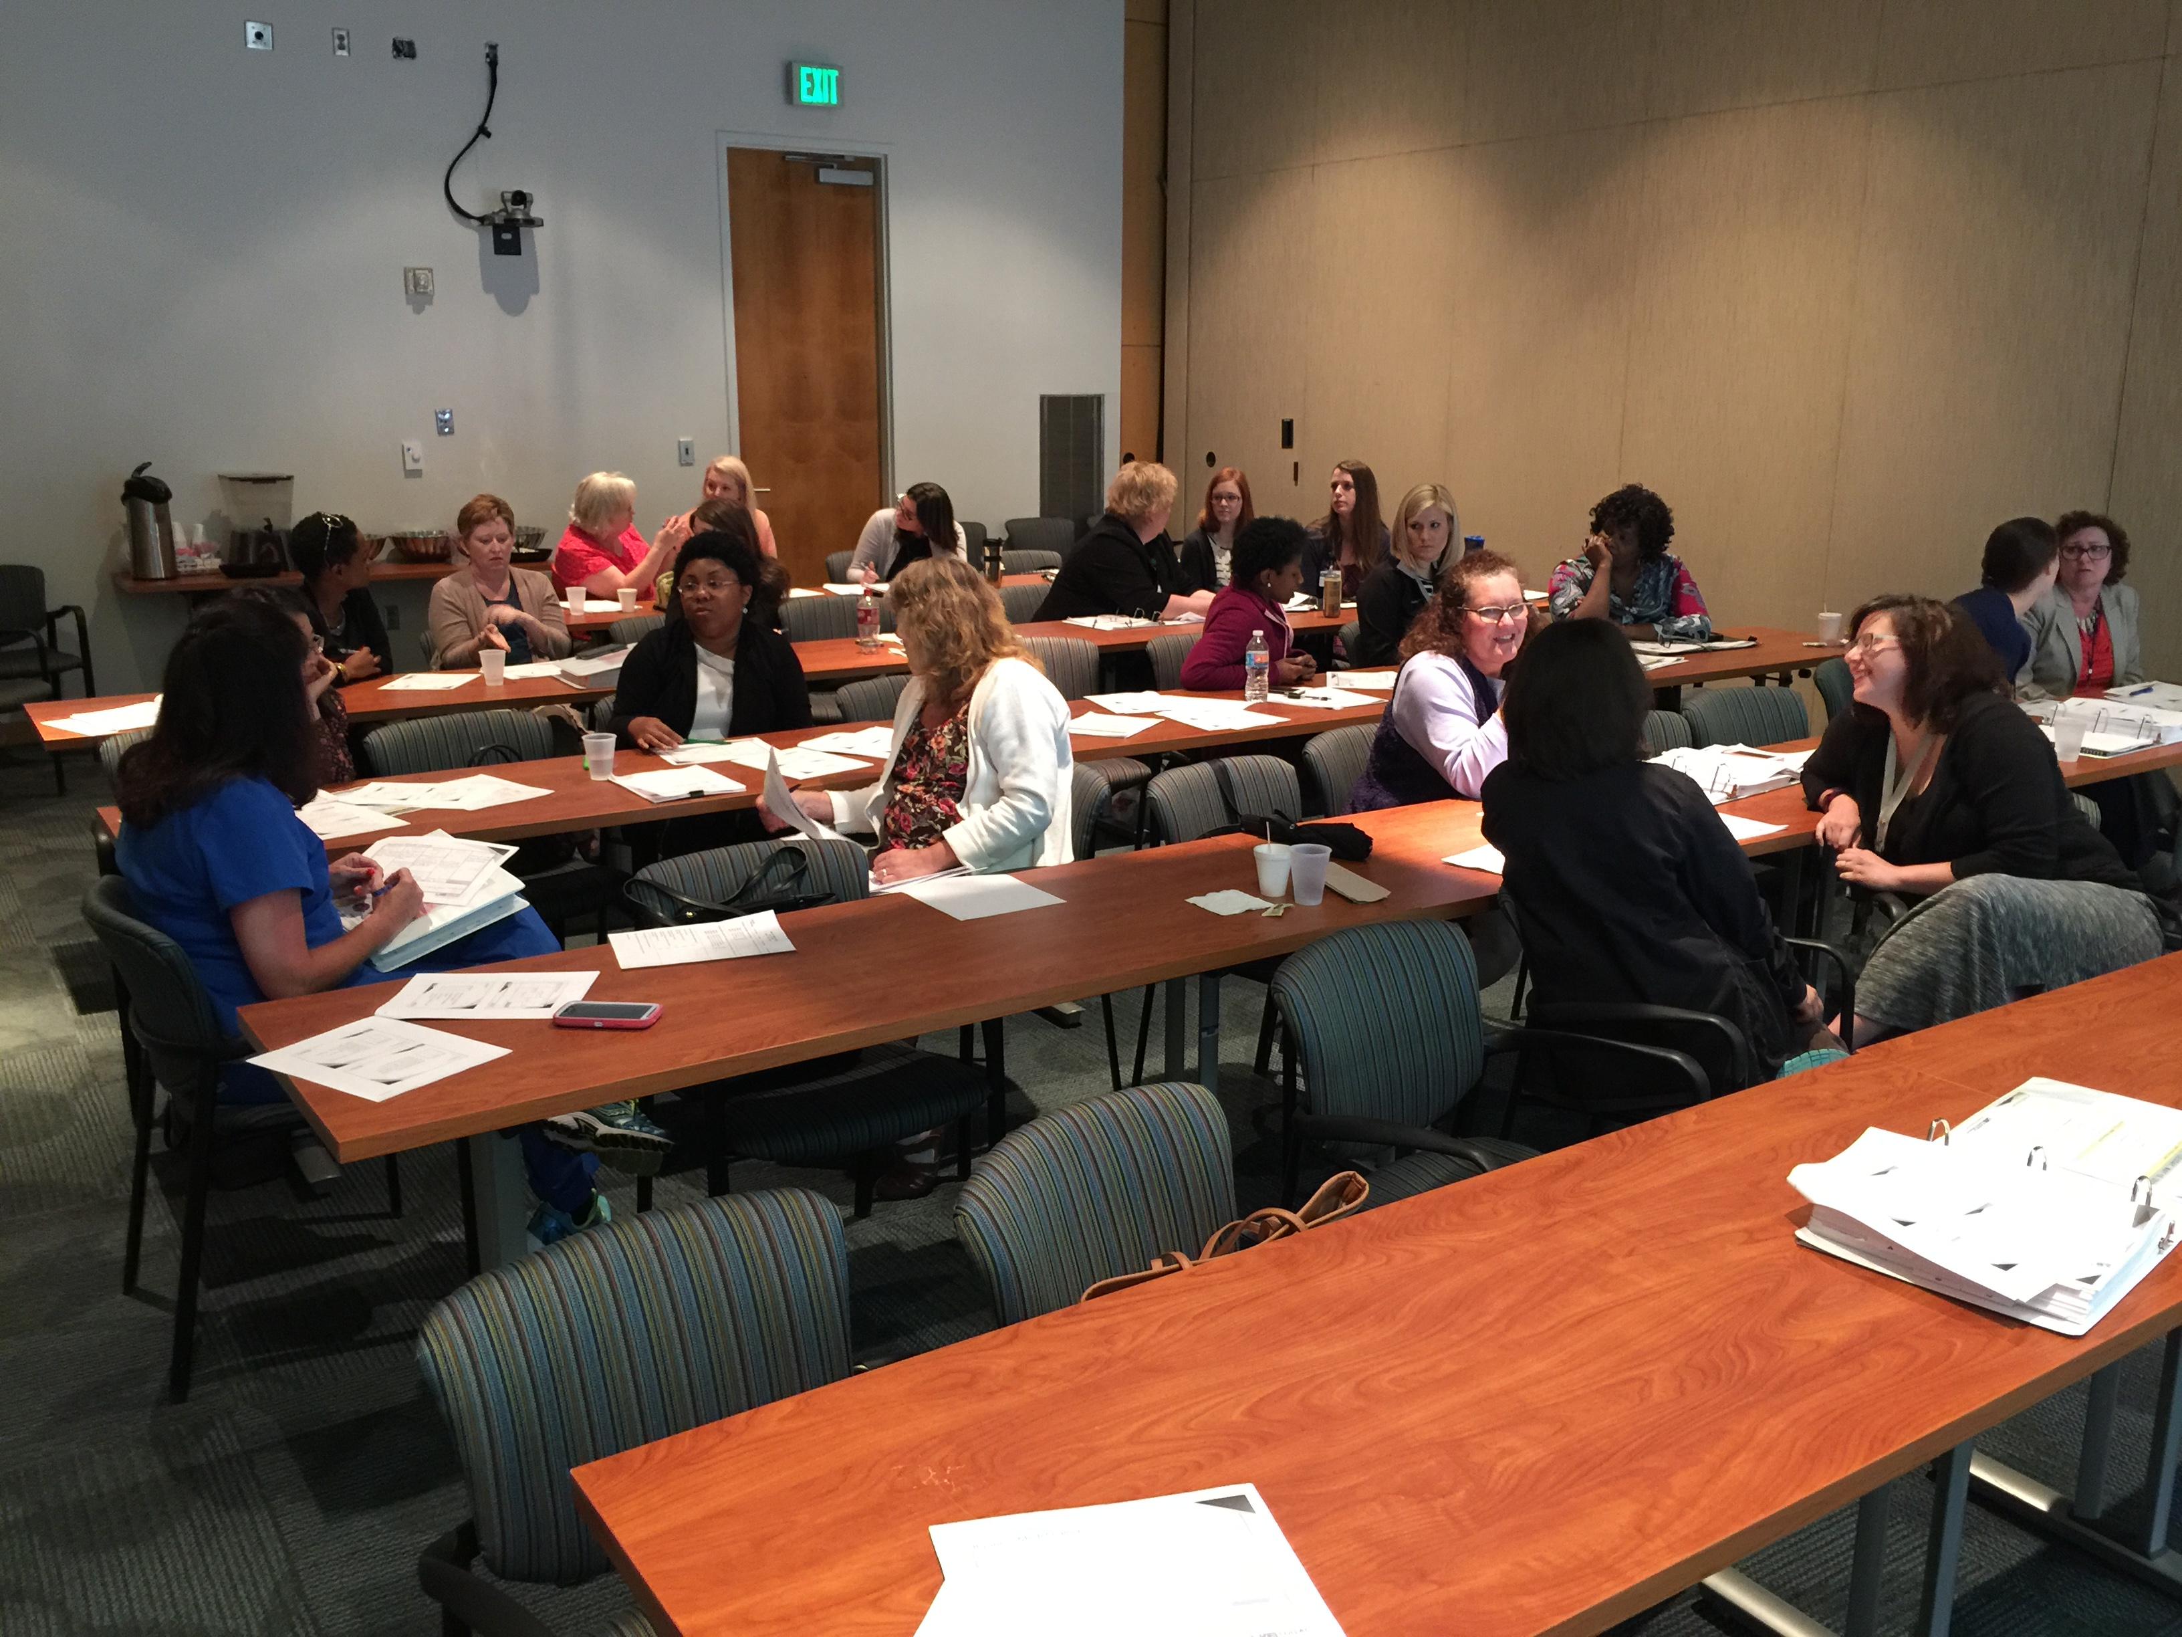
Research Coordinator Training

Slide 55
8th Graders Innovating at Phillips Academy

Slide 56
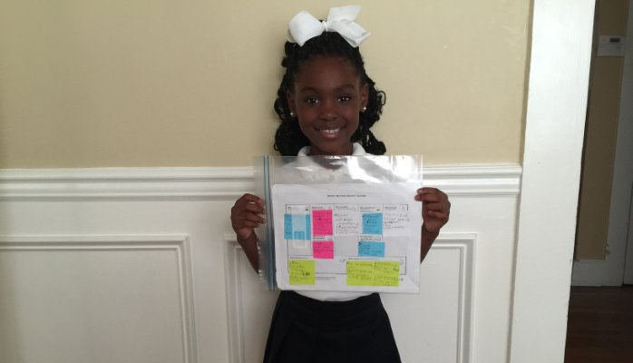
Daddy’s Pooh Pooh (Web-Based Morning Show for Kids)
https://www.linkedin.com/pulse/what-my-7-year-old-taught-me-entrepreneurship-anthony-c-hood-ph-d?trk=prof-post

Slide 57
On-Campus Resources for Team Work
PhD Prep Lab (Evaluation and Assessment, Continuing Education, Professional Development, Strategic Planning Retreats, CBPR, Kickoff Meetings, Grant Writing, etc)
Collat School of Business (Courses in Strategy, Innovation, Leadership, Entrepreneurship)
iLab at Innovation Depot (Event Hosting, Co-working Space, Interns, etc)
Edge of Chaos (4th Floor of Lister-Hill Library)
AHRQ’s TeamSTEPPS (Strategies and Tools to Enhance Performance and Patient Safety)
CO.STARTERS.co

Slide 58
On-Campus Resources for Team Work
Health Care Leadership Academy (Grant Savage and David Rogers)
UAB Quality Enhancement Plan (QEP) - Learning in a Team Environment
UAB Office of Interprofessional Simulation for Innovative Clinical Practice
UAB Organizational Learning and Development (7 Habits, Crucial Conversations, etc)
CCTS – see especially Research Commons, TIERS

Slide 59
The Science of Team Science: Resources
How to write a collaboration plan https://www.teamsciencetoolkit.cancer.gov
COALESCE - CTSA Online Assistance for Leveraging the Science of Collaborative Effort (teamscience.net)
Collaboration and Team Science: A Field Guide (teamscience.nih.gov)
CTSA Clinical & Translational Science Awards (ctsacentral.org)
Northwestern University Clinical and Translational Sciences (NUCATS) Institute (www.scienceofteamscience.org/scits-a-team-science-resources)

Slide 60
The Business of Team Science: Resources
Alabama Launchpad Competition alabamalaunchpad.com
Blank, S. (2013, May). Why the lean startup changes everything. Harvard Business Review, 3-9. https://archive.harvardbusiness.org/cla/web/pl/product.seam?c=29512&i=29514&cs=72931baa3b05f76aca8090b33db139b0
Business Model Innovation businessmodelgeneration.com/canvas
How to Build a Startup udacity.com/course/ep245 (Free Course)
National Science Foundation Innovation Corps Program nsf.gov/i-corps
Notes:
Steve Blank (Entrepreneur, Professor and Developer of NSF’s i-Corp Program) steveblank.com/slides

Slide 61
Questions?

Slide 62
Team Mental Model

Slide 63
Team Mental Model

